Slide 1
Sorting and Searching – Brute Force Approach

Slide 2
Instructor
Dr. Ab Rouf Khan
Assistant Professor
VIT Bhopal University

Slide 3
Entry level Questions
What you mean by brute-force approach?
How to sort and search for the various element in a given array?
How can we improve upon the brute force strategy of problem solving approach?

Slide 4
Outline [Module 2 (Part 1)]
Brute Force Approach: General Method.
Sorting
Bubble Sort
Selection Sort
Insertion Sort
Searching
Sequential / Linear Search

Slide 5
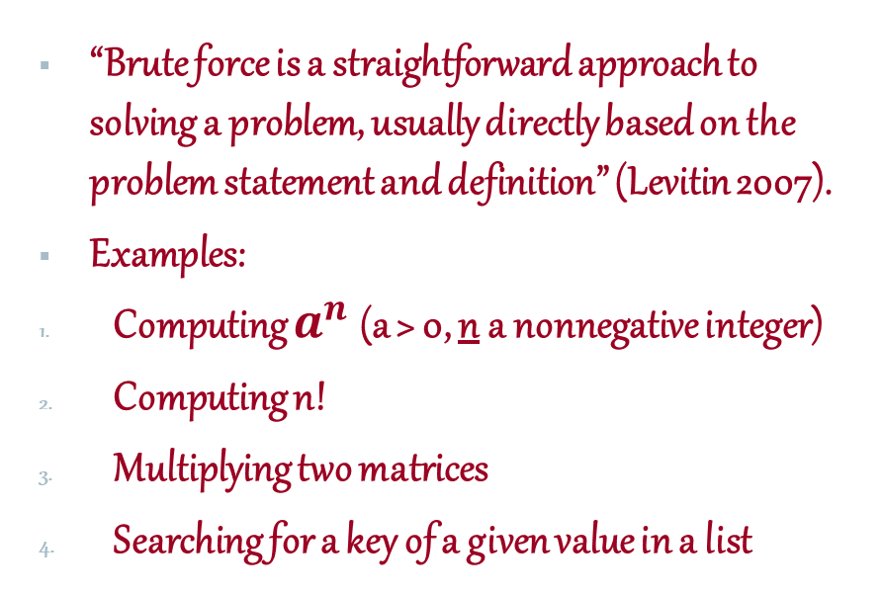
Brute Force Approach of Problem Solving
“Brute force is a straightforward approach to solving a problem, usually directly based on the problem statement and definition” (Levitin 2007).
Examples:
Computing $a^{n}$ (a > 0, n a nonnegative integer)
Computing n!
Multiplying two matrices
Searching for a key of a given value in a list

Slide 6
Motivation behind Brute Force Approach
Brute force is applicable to a wide variety of problems.
For some problems does generate reasonable algorithm.
If the problem is only infrequently solved then the expense of developing a better algorithm is not justified.
The brute force algorithm may be good for small problem size.
Brute force can be used for comparison of more sophisticated algorithms. (Levitin 2007)

Slide 7
The Sorting Problem
The Sorting Problem
Input:
A sequence of n numbers a₁, a₂, . . . , a_{n}
Output:
A permutation (reordering) a₁’, a₂’, . . . , a_{n}’ of the input sequence such that a₁’ ≤ a₂’ ≤ · · · ≤ a_{n}’

Slide 8
Why Study Sorting Algorithms?
There are a variety of situations that we can encounter
Do we have randomly ordered keys?
Are all keys distinct?
How large is the set of keys to be ordered?
Need guaranteed performance?
Various algorithms are better suited to some of these situations.

Slide 9
Some Definitions
Internal Sort
The data to be sorted is all stored in the computer’s main memory. (E.g., Bubble Sort, Insertion Sort, Quick Sort, Heap Sort, Radix Sort, Selection sort)
External Sort
Some of the data to be sorted might be stored in some external, slower, device. (E.g., Merge Sort)
In Place Sort
The amount of extra space required to sort the data is constant with the input size. (E.g., Bubble Sort, Selection Sort)

Slide 10
Selection Sort
Idea
Find the smallest element in the array
Exchange it with the element in the first position
Find the second smallest element and exchange it with the element in the second position
Continue until the array is sorted

Slide 11
Example
Example!
8
4
6
9
2
3
1
1
2
3
4
9
6
8
1
4
6
9
2
3
8
1
2
3
4
6
9
8
1
2
6
9
4
3
8
1
2
3
4
6
8
9
1
2
3
9
4
6
8
1
2
3
4
6
8
9

Slide 12
Pseudocode
Alg.: SELECTION-SORT(A)
n ← length[A]
for j ← 1 to n - 1
do smallest ← j
for i ← j + 1 to n
do if A[i] < A[smallest]
then smallest ← i
exchange A[j] ↔ A[smallest]

Slide 13
Analysis of Selection Sort
Analysis of Selection Sort
Alg.: SELECTION-SORT(A)
n ← length[A]
for j ← 1 to n - 1
do smallest ← j
for i ← j + 1 to n
do if A[i] < A[smallest]
then smallest ← i
exchange A[j] ↔ A[smallest]
cost times
c₁ 1
c₂ n
c₃ n-1
c₄
c₅
c₆
c₇ n-1
n²/2
comparisons
n
exchanges

Slide 14
Bubble Sort
Idea
Repeatedly pass through the array
Swaps adjacent elements that are out of order
i
1
2
n
8
4
6
9
2
3
1
j

Slide 15
Example
Example!
8
4
6
9
2
3
1
1
8
4
6
9
2
3
i = 1
j
i = 2
j
8
4
6
9
2
1
3
1
2
8
4
6
9
3
i = 1
j
i = 3
j
8
4
6
9
1
2
3
1
2
3
8
4
6
9
i = 1
j
i = 4
j
8
4
6
1
9
2
3
1
2
3
4
8
6
9
i = 1
j
i = 5
j
8
4
1
6
9
2
3
1
2
3
4
6
8
9
i = 1
j
i = 6
j
8
1
4
6
9
2
3
1
2
3
4
6
8
9
i = 1
j
i = 7
1
8
4
6
9
2
3
j
i = 1
j

Slide 16
Pseudocode
Alg.: BUBBLESORT(A)
for i ← 1 to length[A]
do for j ← length[A] downto i + 1
do if A[j] < A[j -1]
then exchange A[j] ↔ A[j-1]

Slide 17
Analysis of Bubble Sort
Alg.: BUBBLESORT(A)
for i ← 1 to length[A]
do for j ← length[A] downto i + 1
do if A[j] < A[j -1]
then exchange A[j] ↔ A[j-1]
c₁
c₂
Comparisons: ≈ n²/2
c₃
Exchanges: ≈ n²/2
c₄
T(n) =
c₁(n+1) +
c₂
c₃
c₄
= Θ(n) +
(c₂ + c₂ + c₄)
Thus, T(n) = Θ(n²)

Slide 18

Recap

Slide 19
Thank You

